Slide 1

Influence of sleep disturbances and brain volume in Alzheimer's disease
Antonia Bonfa
Weiping Zhang

Slide 2
Motivation
Why?
sleep disturbances significantly associated with AD pathologies conversion and cognitive diagnosis. (Shokouhi 2019, Lloret MA 2020, et al.)
AD brain shrinks faster than normal brain. Abnormal brain atrophy starts often at the beginning of MCI stage.
Aspects
Sleep disturbances VS AD cognitive conversion
Brain volumes VS AD cognitive conversion
Sleep disturbances + brain volumes VS AD cognitive diagnosis
MRI scans analysis

Slide 3
Sleep disturbances
What are sleep disturbances?
Insomnia: Difficulty falling asleep or staying asleep
Obstructive sleep apnea (OSA): brief partial or complete collapse of the airways during sleep
Other sleep disturbances: pacing during the night, excessive sleep during the day
How did we select / mark them?
OSA and insomnia: flagged from medical history and symptoms checklist
Other symptoms: collected from the NPIK Questionnaire

Slide 4
Methods of machine learning
10-fold cross-validation instead of one-time train-test split
Under-sampling to balance classes
Model selection (168 models)
Data type: raw data, standard scaled data, PCA transformed data
Classification methods and corresponding hyperparameter tuning:
Logistic regression
Regularization strength: [0.001,0.01,0.1,1,10,100,1000]
Optimization algorithms: lbfgs, saga, newton
Penalty: l1, l2
Decision tree
Tree-depth: in range (1, 15)
Random forest
Number of trees: (5, 100)
MLP (multi-layer perceptron)
Hidden layer sizes: [20,20], [50,50], [100,100]
Random forest on under-sampled raw data, with 10-fold cross-validation

Slide 5
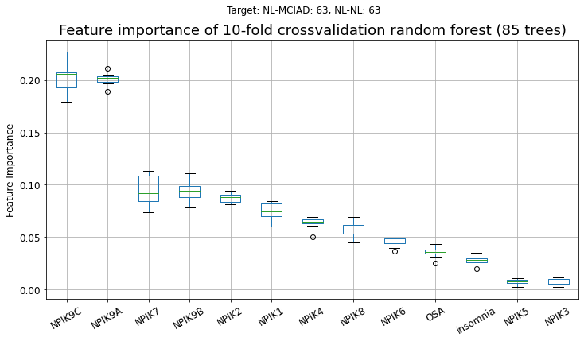
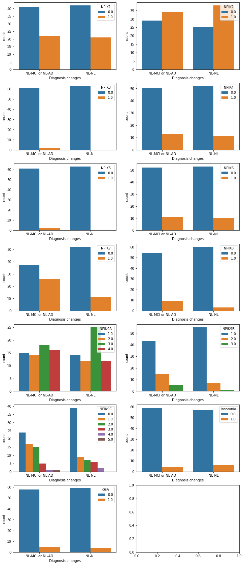
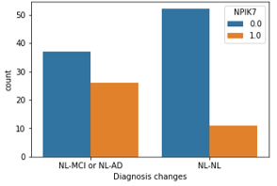
1. Sleep disturbances vs cognitive conversion
Bad conversion?
13 sleep disturbances features
Binary classification
Bad conversion: NL --> MCI/AD
No: NL --> NL
63 observations in each class
F1-score: 0.61
Caregiver Distress
Disturbances Frequency
Excessive Daytime Sleep

Slide 6
1. Sleep disturbances vs cognitive diagnosis conversion
Goal | Target labels | F1-score | 1st important feature | 2nd important feature | 3rd important feature
Bad conversion? | NL --> MCI/AD Nl --> NL | 0.61 | Caregiver Distress | Disturbances Frequency | Excessive daytime sleep
 | MCI --> AD MCI --> MCI/NL | 0.70 | Caregiver Distress | Disturbances Frequency | Excessive daytime sleep
good conversion? | MCI --> NL MCI --> MCI/AD | 0.60 | Caregiver Distress | Disturbances Frequency | OSA
- more males get troubled with sleep disturbances than females

Slide 7
2. Relative brain volume vs cognitive diagnosis conversion
Input features: relative volumes of 6 brain regions
Binary classification: conversion or not?
Goal | Target labels | F1-score | 1st important feature | 2nd important feature | 3rd important feature
Bad conversion? | NL --> MCI Nl --> NL | 0.61 | Ventricles | Entorhinal | Fusiform
 | MCI --> AD MCI --> MCI/NL | 0.80 | Ventricles | Hippocampus | Entorhinal
Good conversion? | MCI --> NL MCI --> MCI/AD | 0.62 | ICV (Total intracranial volume) | Wholebrain | Fusiform
 | AD --> MCI/NL AD --> AD | 0.68 | ICV | Fusiform | Ventricles
* All brain volumes are relative brain volume, which means divided by values of first visit

Slide 8
Predicting change from MCI or NL to AD
Random forest using insomnia, OSA and NPIKTOT as well as brain volume to predict AD patients in the MCL-AD and NL-AD patient group
Method | F1-score
No sleep markers, using ratio of brain volume | 0.738
Using insomnia & ratio of brain volume | 0.734
Using OSA & ratio of brain volume | 0.731
Using NPIKTOT & ratio of brain volume | 0.733
Using all of them and ratio of brain volume | 0.745

Slide 9


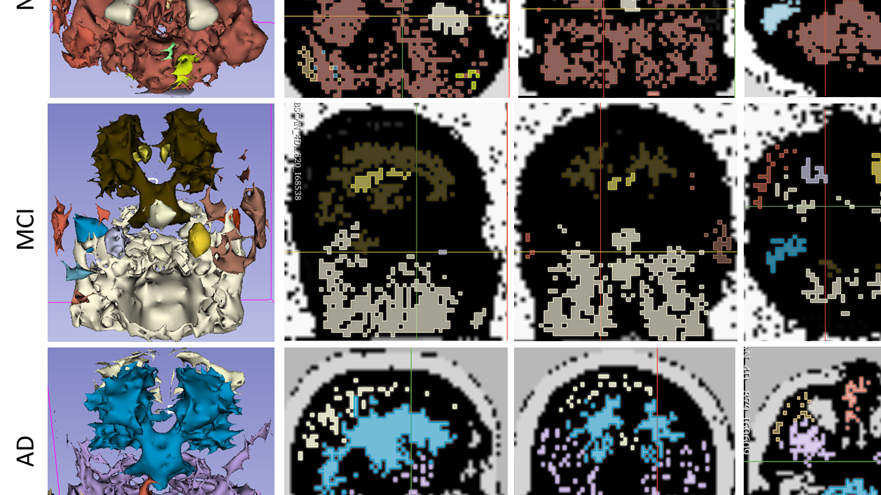



MRI segmentation by HDBSCAN

Slide 10
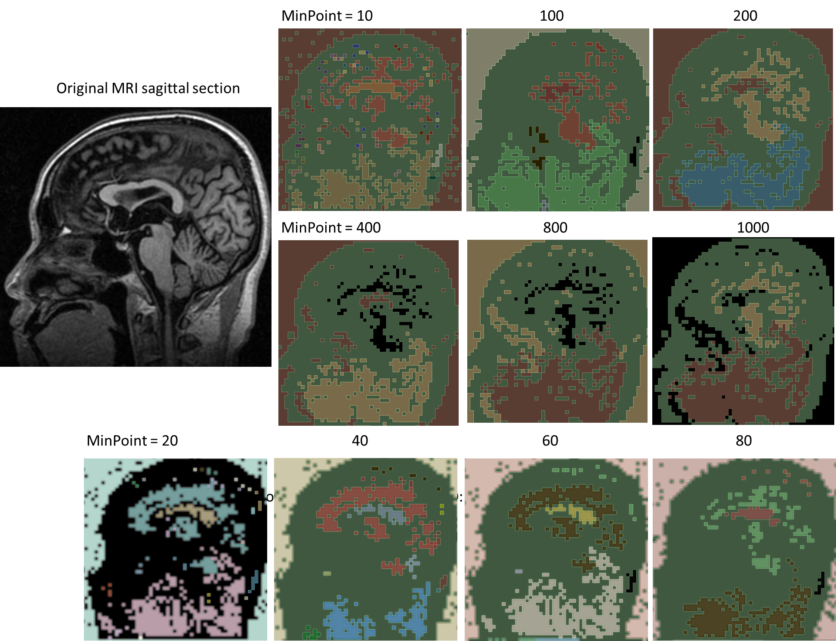
HDBSCAN Parameter tuning
MCI stage brain
Resolution: 64 x 64 x 64
MinPoint: minimum number of neighbors to a core point

Slide 11
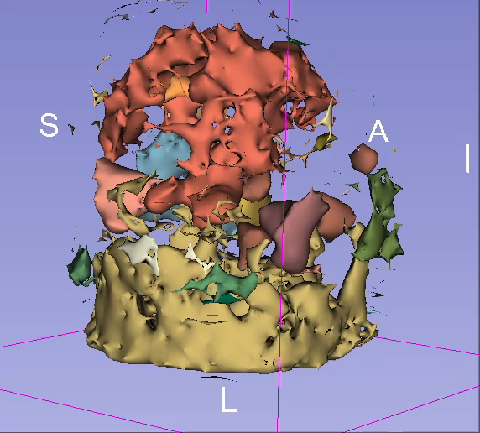
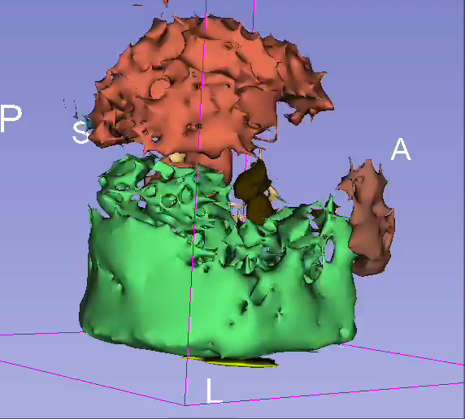
HDBSCAN Parameter tuning
Resolution: 64 x 64 x 64
MinPoint: minimum number of neighbors to a core point

Slide 12
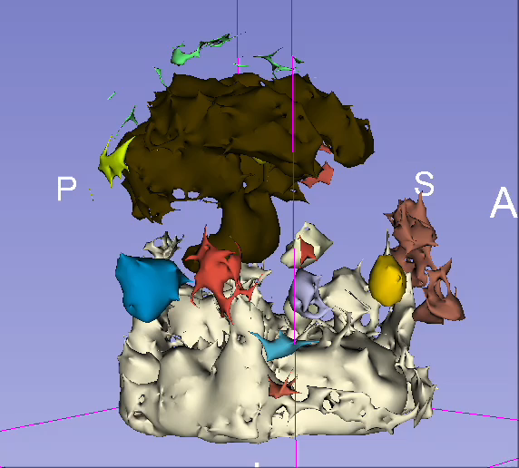
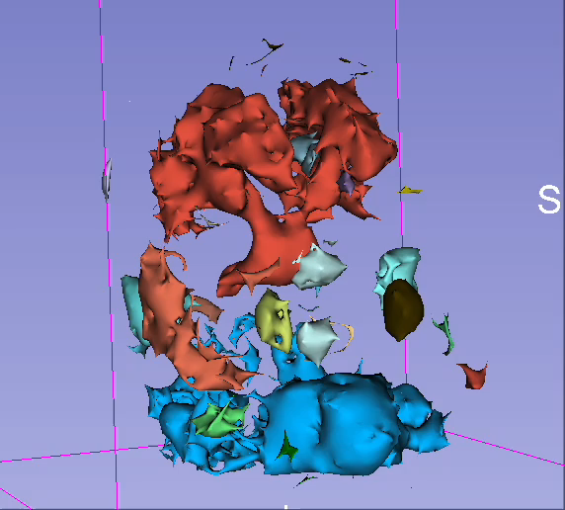
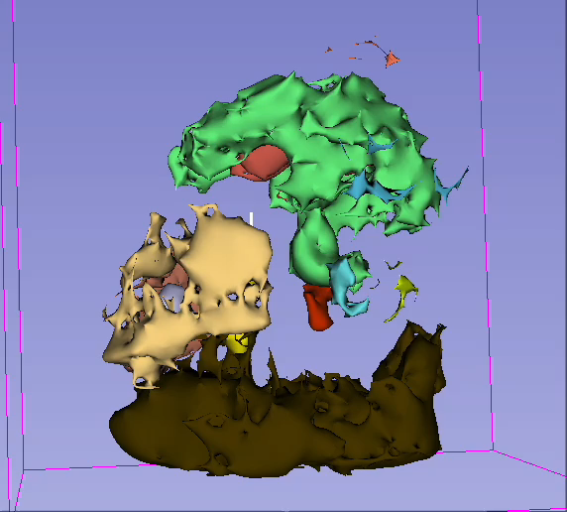
HDBSCAN Parameter tuning
Resolution: 64 x 64 x 64
MinPoint: minimum number of neighbors to a core point

Slide 13
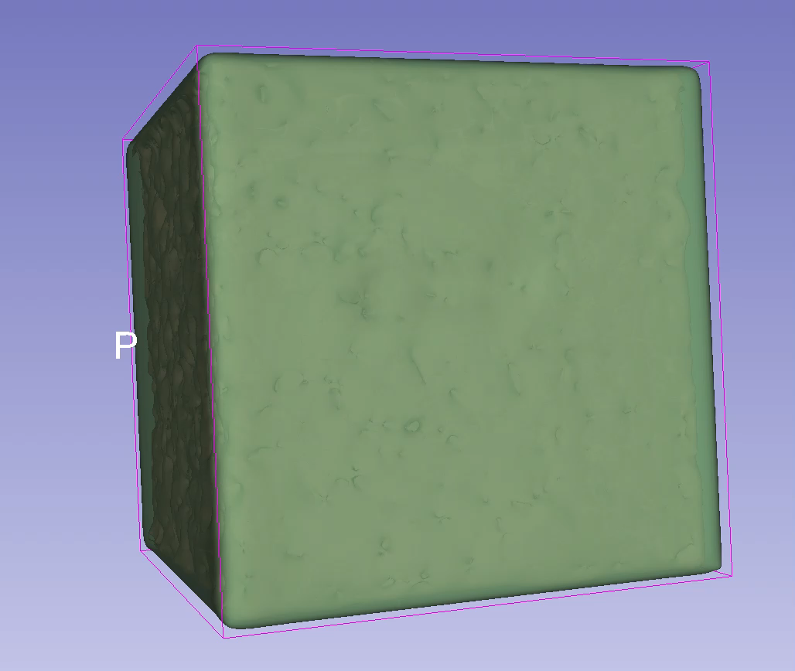
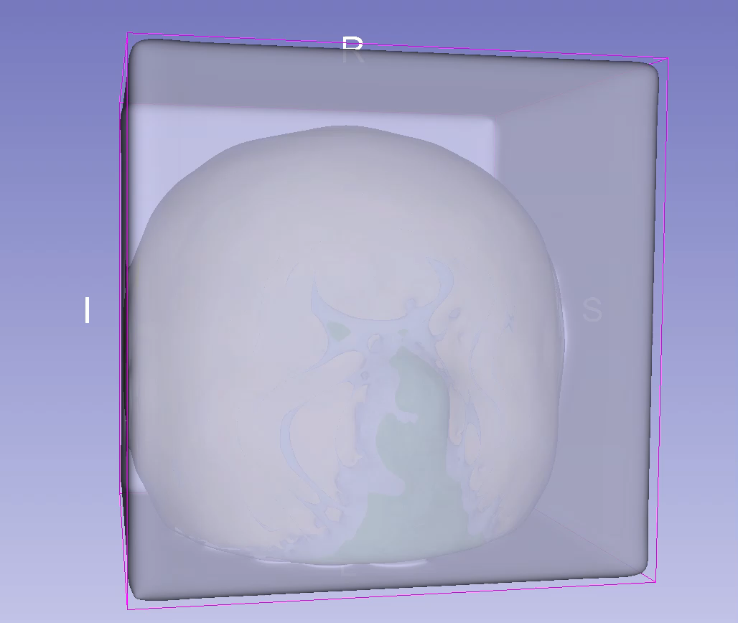
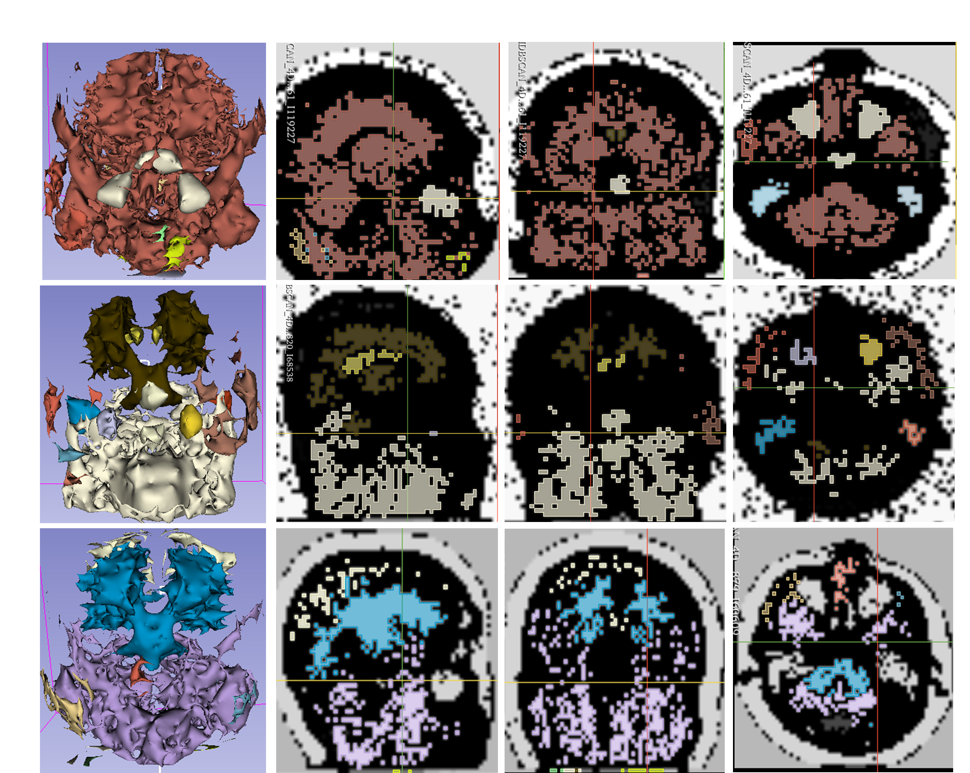
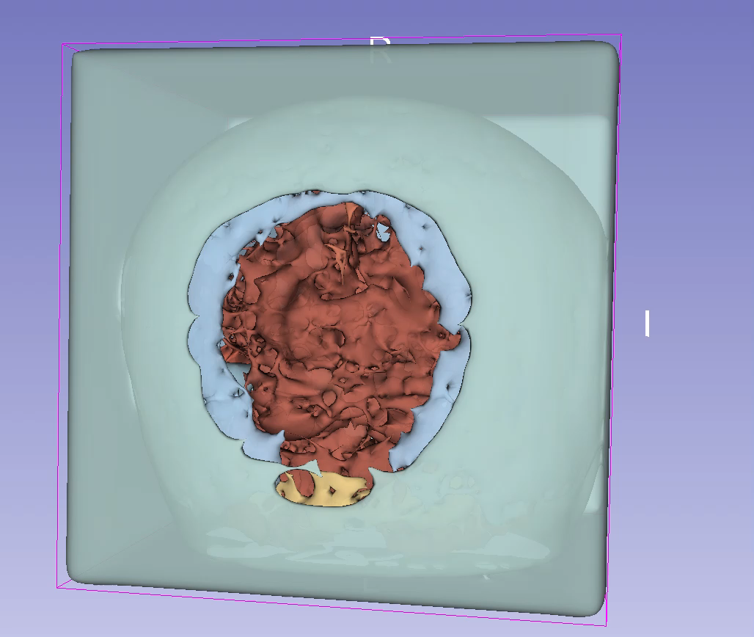
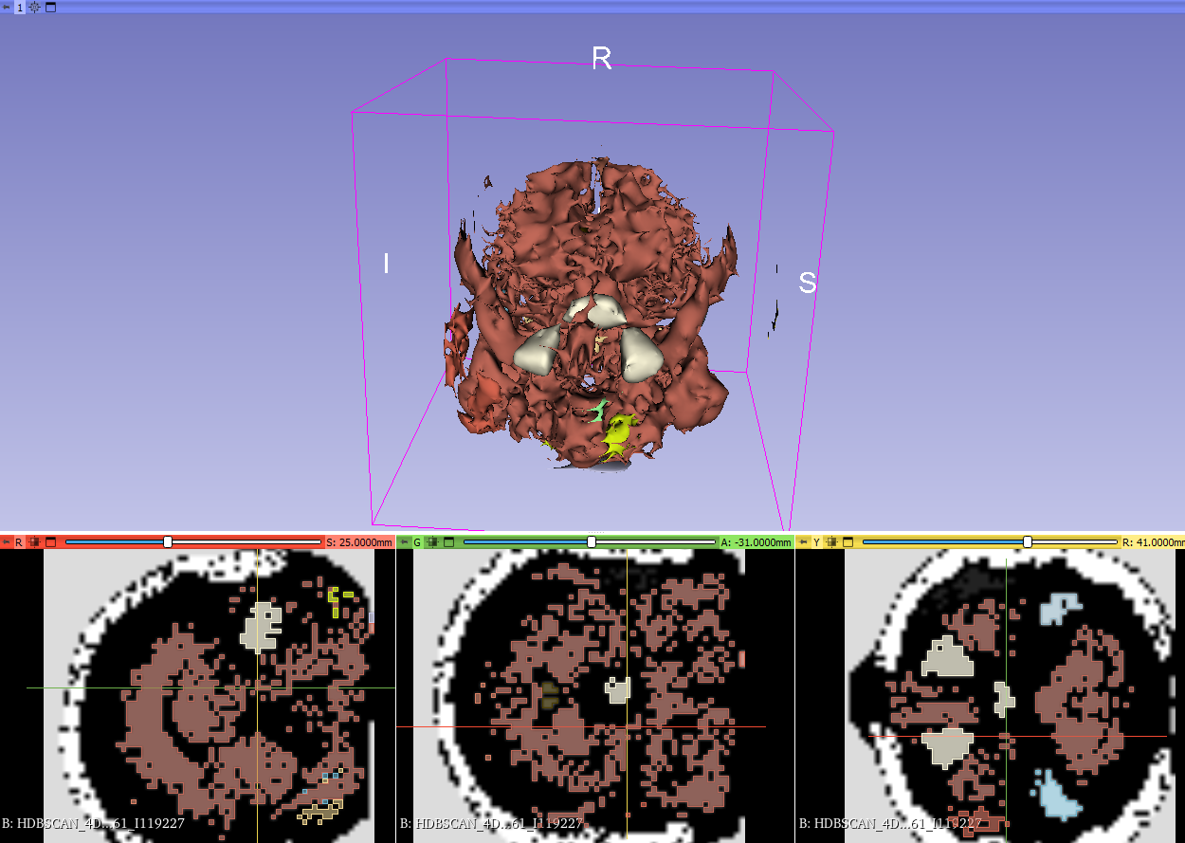
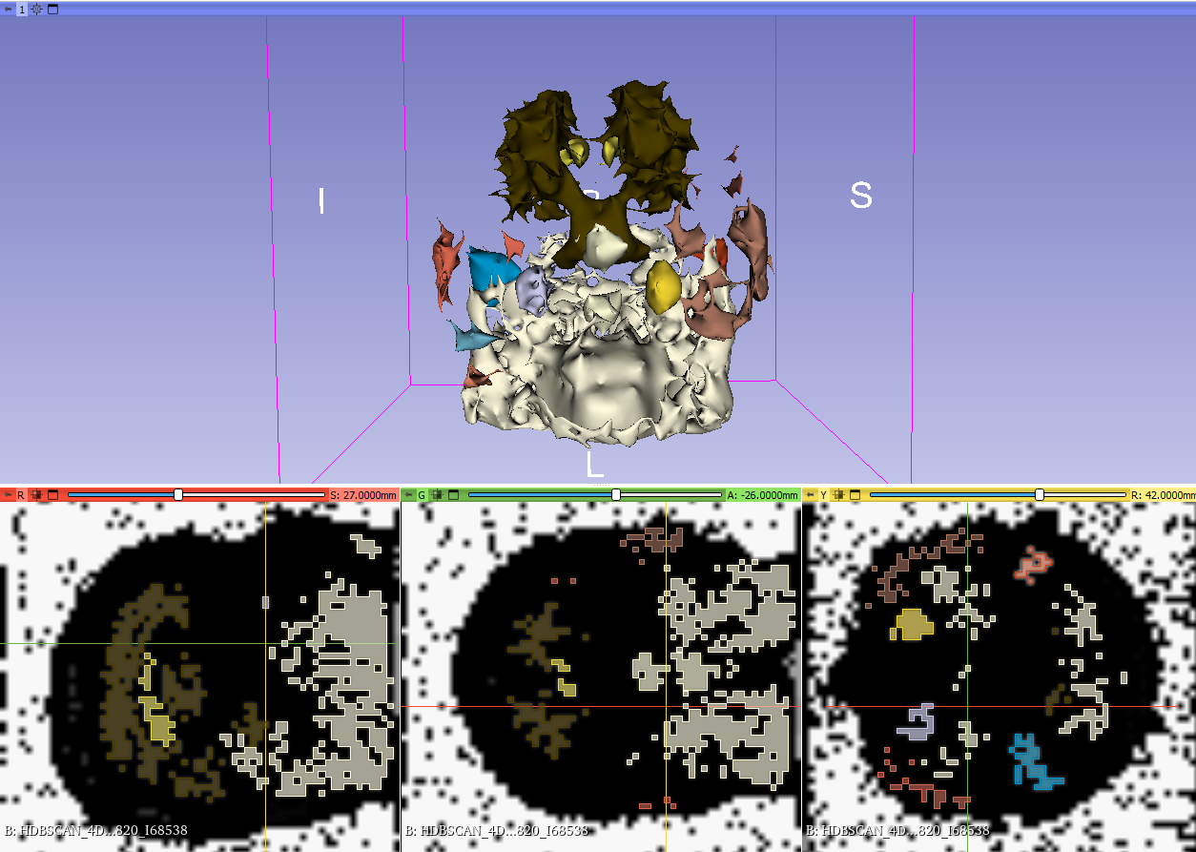
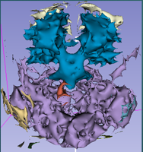
Results

Slide 14
Caveats
Potential cofounding factors:
Depression / Anxiety and medications
Not enough domain knowledge about medications (i. E. which medications would we need to look out for?)
Not enough domain knowledge about effects of medications on depression and anxiety: would a patient treated for depression also potentially be treated for insomnia?
Ethnicities:
not many datapoints for insomnia, OSA or NPIK
Data quality
Most sleep disturbances measured only by self reported data

Slide 15
Conclusion
patients suffering from AD or MCI may have a slower progression of cognitive decline if their support system is less distressed.
Treating sleep disorders and OSA could have a positive effect on the progression of AD.
Further studies using other sleep data, such as obtained in a sleeping lab, may be able to get more conclusive results.
HDBSCAN could potentially, with some improvements, be used to identify abnormal brain structures

Slide 16
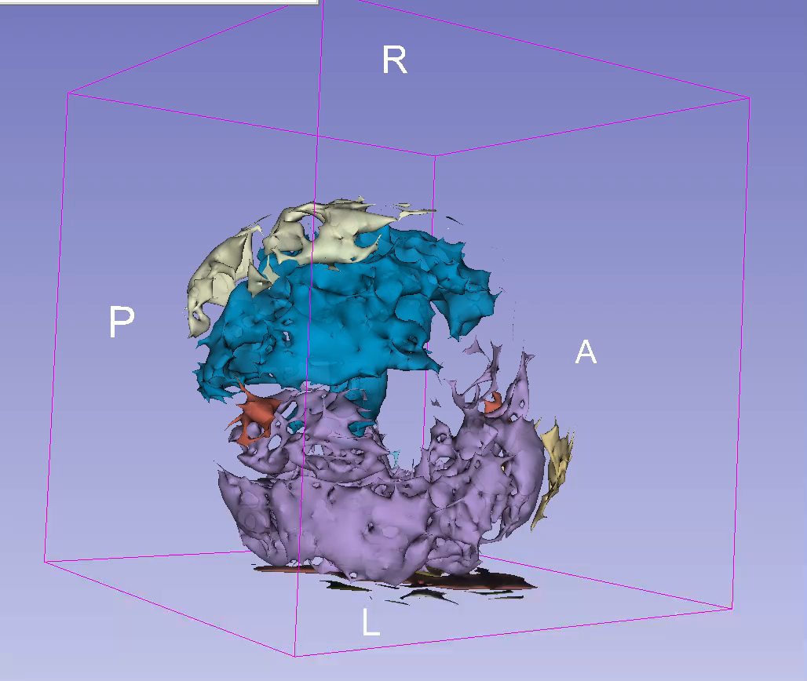
Thank you
16

Slide 17
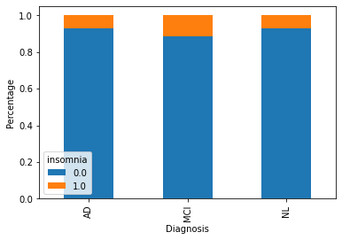
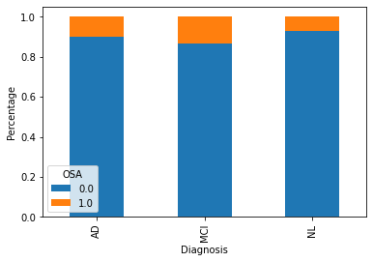
Features and how we got them
NPIK Questionnaire
Obstructive sleep apnea and insomnia
Extracted from medical data using key-word-search
Insomnia was flagged for each visit
OSA was flagged for each patient
Brain volumes
Relative brain volumes: brain volumes divided by the measurement at first visit

Slide 18
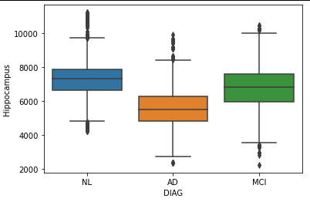
Brain volumes (one Chart with all the brain measurements)
Brain size decreases over time, but moreso in AD patients

Slide 19
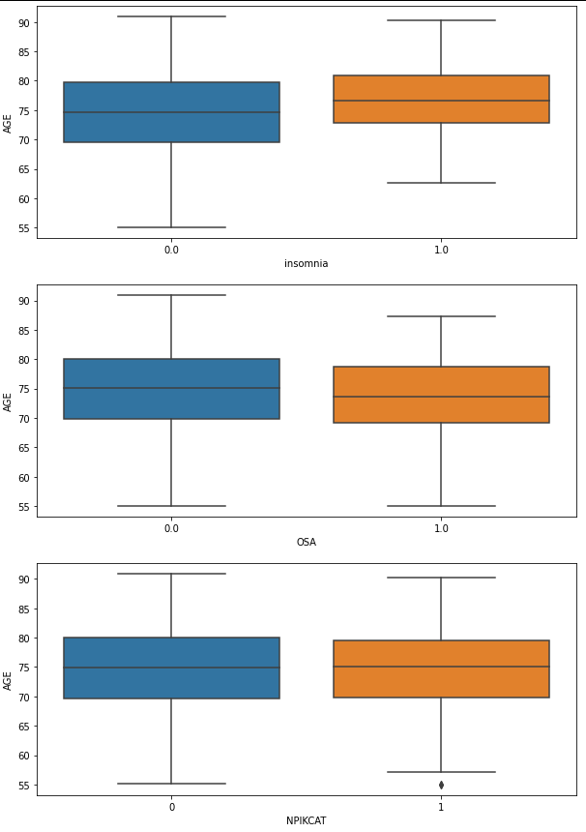
Do patients with sleep disturbances get diagnosed with AD earlier?
Age when diagnosed with Alzheimers
insomnia | count | mean | std | min | median | max
no | 677 | 74.272378 | 7.683623 | 55.0 | 74.7 | 90.9
yes | 49 | 76.336735 | 6.377653 | 62.7 | 76.7 | 90.3
OSA | count | mean | std | min | median | max
no | 661 | 74.588502 | 7.601155 | 55.1 | 75.1 | 90.9
yes | 65 | 72.613846 | 7.596131 | 55.0 | 73.6 | 87.3
NPIKCAT | count | mean | std | min | median | max
Low (<=3) | 612 | 74.440523 | 7.688397 | 55.1 | 74.9 | 90.9
High (>3) | 114 | 74.257018 | 7.248130 | 55.0 | 75.1 | 90.3

Slide 20
Sleep Marker | NL | MCI | AD
OSA no | 0.400851 | 0.405355 | 0.193794
OSA yes | 0.271871 | 0.551817 | 0.176312
Insomnia no | 0.391742 | 0.410093 | 0.198165
Insomnia yes | 0.347781 | 0.524252 | 0.127967
NPIKCAT low | 0.400375 | 0.407416 | 0.192209
NPIKCAT high | 0.340143 | 0.468594 | 0.191263

